Slide 2
Implementation of a Sub-Sampling PLL targeting SerDes Applications
Christof Gindu, BSc Rohish Kumar Reddy Mitta, MSc
Univ.-Prof. Dr. Harald Pretl

Slide 3
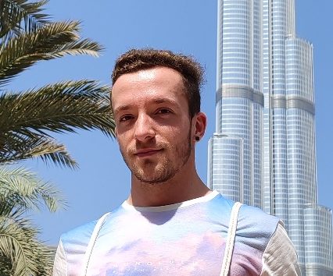

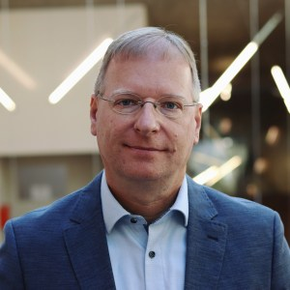
Team
Christof Gindu, BSc Student
Rohish Kumar Reddy Mitta, MSc PhD candidate, supervisor
Univ.-Prof. Dr. Harald Pretl head of institute, supervisor

Slide 4
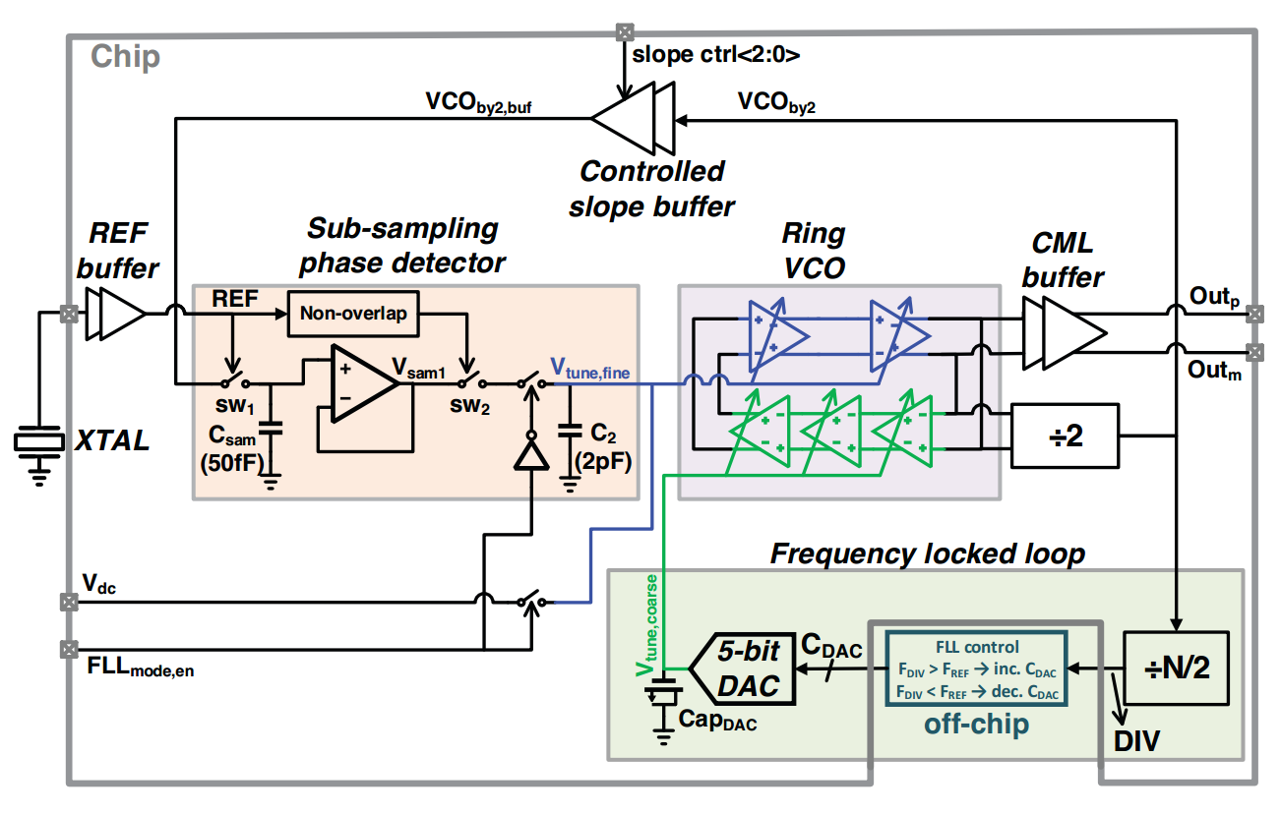
Block schematic
S. S. Nagam and P. R. Kinget, "A 0.008mm2 2.4GHz type-I sub-sampling ring-oscillator-based phase-locked loop with a −239.7dB FoM and −64dBc reference spurs," 2018 IEEE Custom Integrated Circuits Conference (CICC), 2018, pp. 1-4, doi: 10.1109/CICC.2018.8357091.

Slide 5
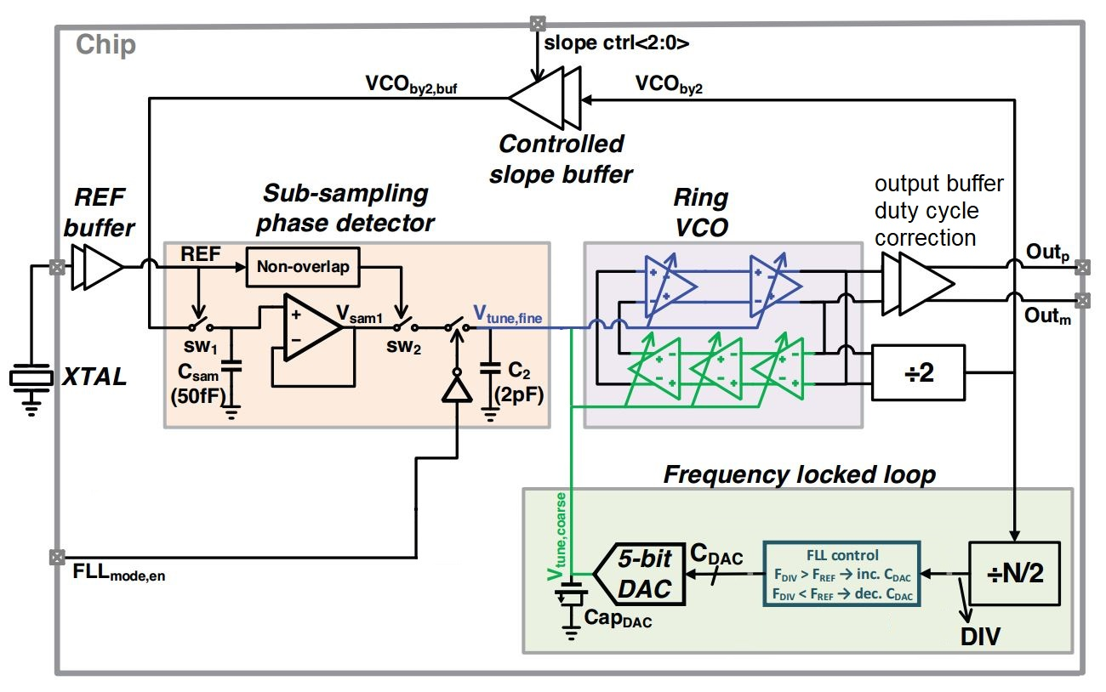
Proposed block schematic

Slide 6
Specifications
Center frequency = 1.25 GHz -> SerDes Applications
Input frequency = 10-100 MHz (26 MHz) (mobile Applications)
Power supply = 1.80V
Power budget = 5 mW maximum
Design focus on low power consumption (switching off circuit components)
Design focus on PVT corners

Slide 7
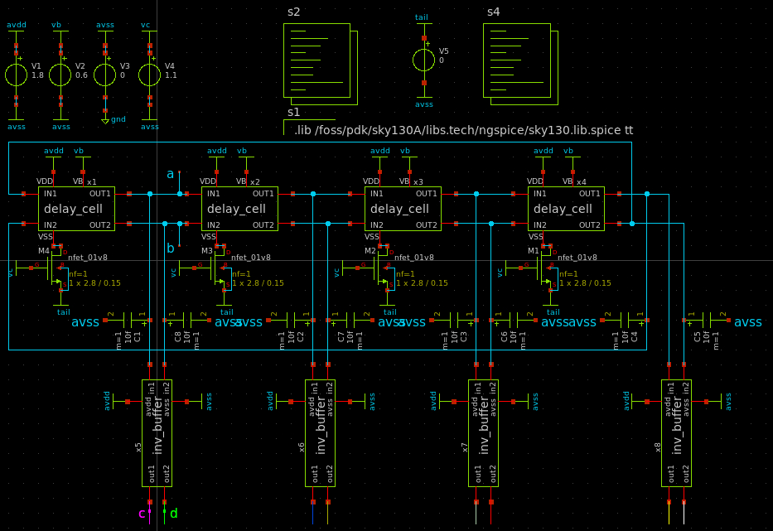
Ring VCO simulation

Slide 8
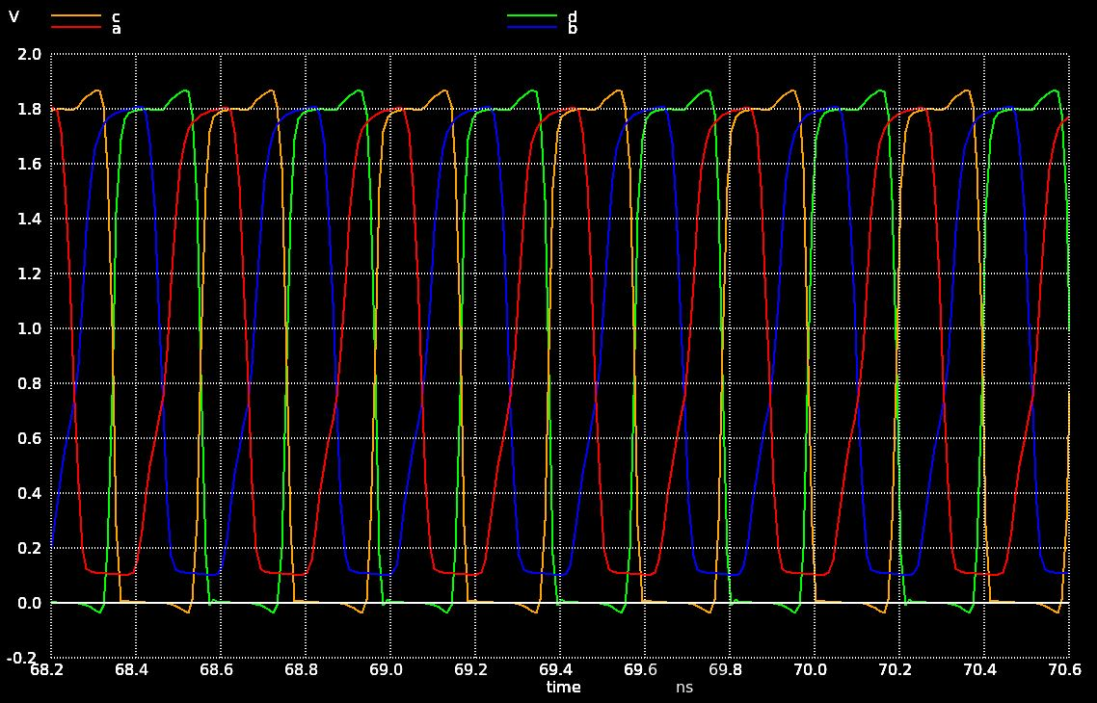
Simulation results

Slide 9
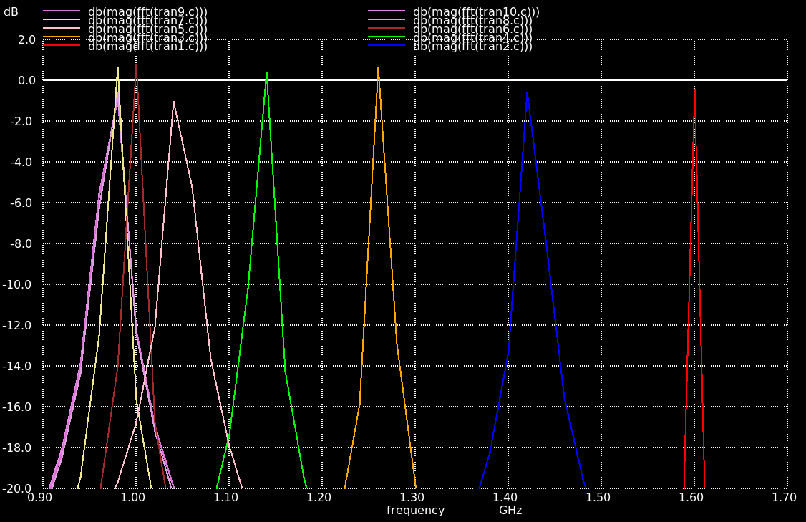
Simulation results

Slide 10
VCO behavior

Slide 11
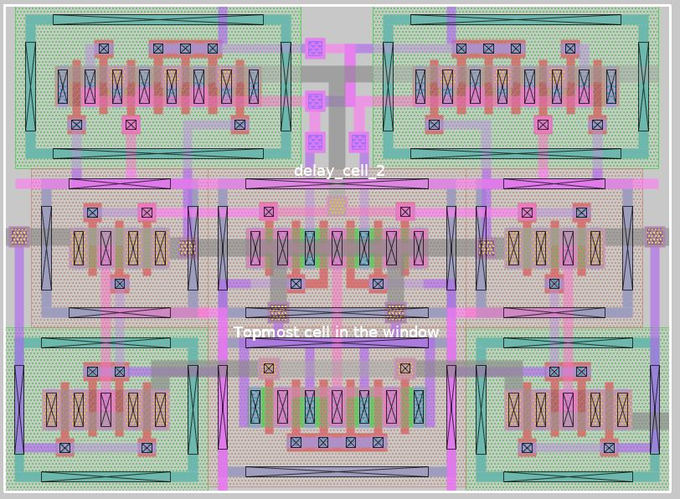
Layout of the delay cell

Slide 12
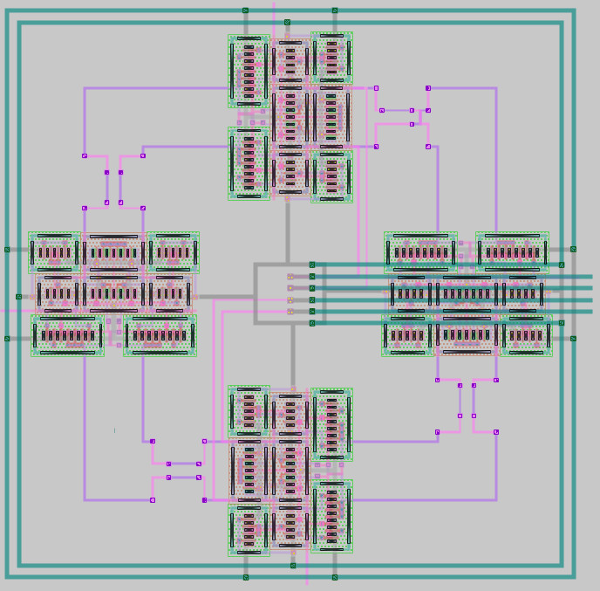
Layout of the complete ring VCO

Slide 13
Next steps
Improve top speed of ring VCO
Improve tuning range of ring VCO
Start with extractions
Continue with next circuit components

Slide 14
Design challenges
Extractions for LVS
Parasitic extraction
Incorporating all PVT corners

Slide 15
Thank you!
Any questions / recommendations / feedback?

